Slide 2
Big oh notation:O
The function f(n)=O(g(n)) (read as “f of n is big oh of g of n”) iff there exist positive
constants c and n0 such that f(n)≤C*g(n) for all n, n≥0
The value g(n)is the upper bound value of f(n).
Example:
3n+2=O(n) as
3n+2 ≤4n for all n≥2

Slide 3
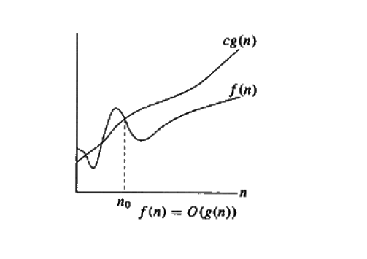

Slide 4
Omega notation:Ω
The function f(n)=Ω (g(n)) (read as “f of n is Omega of g of n”) iff there exist positive
constants c and n0 such that f(n)≥C*g(n) for all n, n≥0
The value g(n) is the lower bound value of f(n).
Example:
3n+2=Ω (n) as
3n+2 ≥3n for all n≥1
Theta

Slide 5
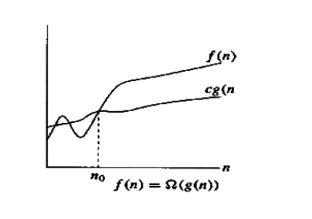

Slide 6
Theta notation:θ
The function f(n)= θ (g(n)) (read as “f of n is theta of g of n”) iff there exist positive
constants c1, c2 and n0 such that C1*g(n) ≤f(n)≤C2*g(n) for all n, n≥0
Example:
3n+2=θ (n) as
3n+2 ≥3n for all n≥2
3n+2 ≤3n for all n≥2
Here c1=3 and c2=4 and n0=2

Slide 7
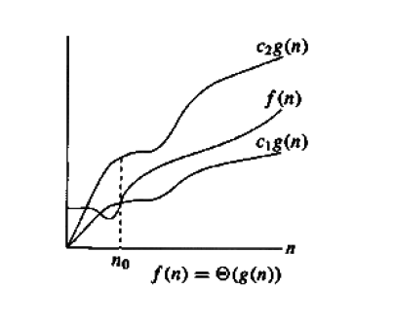

Slide 8
Little oh: o
The function f(n)=o(g(n)) (read as “f of n is little oh of g of n”) iff
Lim f(n)/g(n)=0 for all n, n≥0
n→~
Example:
3n+2=o(n2) as
Lim ((3n+2)/n2)=0
n→~
Little Omega:ω
The function f(n)=ω (g(n)) (read as “f of n is little ohomega of g of n”) iff
Lim g(n)/f(n)=0 for all n, n≥0
n→~
Example:
3n+2=o(n2) as
Lim (n2/(3n+2) =0
n→~

Slide 9
AnalyzingAlgorithms
Suppose ‘M’ is an algorithm, and suppose ‘n’ is the size of the input data. Clearly the
complexity f(n) of M increases as n increases. It is usually the rate of increase of f(n) we
want to examine. This is usually done by comparing f(n) with some standard functions.
The most common computing timesare:
O(1), O(log2n), O(n), O(n. log2n), O(n2), O(n3), O(2n), n! andnn
Numerical Comparison of DifferentAlgorithms
The execution time for six of the typical functions is givenbelow:

Slide 10
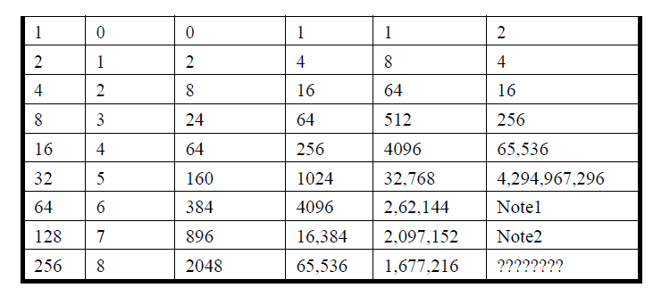

Slide 11
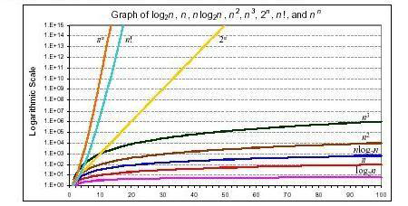
Graph of log n, n, n log n, n2, n3, 2n, n! andnn

Slide 12
One way to compare the function f(n) with these standard function is to use the functional
‘O’ notation, suppose f(n) and g(n) are functions defined on the positive integers with the
property that f(n) is bounded by some multiple g(n) for almost all ‘n’.Then,f(n) =O(g(n))
Which is read as “f(n) is of order g(n)”. For example, the order of complexityfor:
• Linear search is O(n)
• Binary search is O (logn)
• Bubble sort is O(n2)
• Merge sort is O (n logn)
Probabilistic analysis of algorithms is an approach to estimate the computational
complexity of an algorithm or a computational problem. It starts from an assumption about
a probabilistic distribution of the set of all possible inputs. This assumption is then used to
design an efficient algorithm or to derive the complexity of a known algorithm.

